Slide 1
Client Name . Text Analysis Overall Report with Cross-Comparisons
2022

Slide 2
Interpretation Notes
While Eigenvalues* are typically used in research to understand the significance of topics/themes within the overall data, they do not give a clear sense of the frequency of a topic/theme. In our application of the model, the goal is to give a client a sense of where they can make the most impact by reporting the themes by frequency.
It is important to note that many respondents speak to multiple topics/themes, even when asked to narrow into ‘one thing’. Each Count is the number of comments that speak to a given topic/theme, but any one comment may be categorized into multiple topics/themes if a respondent spoke to multiple items.
This report is meant to identify the broad themes that are most prevalent in the data, while more specific insights can be drawn by exploring verbatim rater comments. The descriptions and representative comments listed in the report for each theme speak to this nuance as it was recorded/understood by the researcher. Overall, these results provide information regarding themes representative of what is generally most important to respondents.
* See the ‘Coherence and Eigenvalue Measures’ slide in the Appendix for more information.

Slide 3
Key Insights (Overall)
Question: What is one thing that Company could do to improve your work experience?
When thinking about their own work experience, respondents showed a clear focus on customer experience. The top two emerging themes in the analysis discuss improving customer experience, both by improving Coordination of Service Provisions and through Infrastructure Investments.
Related to customer experience, respondents also identified a need for improved/updated tools for them to better serve customers, including a Need for Expanded and Upgraded Fleet and to Update Computers and Systems.
Respondents noted that they are feeling undervalued, unheard, and/or spread thin, which emerged in the topics Listen to / Respect Front-Line Employees, Management Concerns, and Work-Life Balance.
Respondents also noted a need to Increase Wages and Benefits to Adjust for Cost of Living.

Slide 4
Results Overview
Total Comments = 10,109
* ‘Count as Percentage of Total’ does not convey proportion of total comments (values will not sum to 100%). Even when prompted to list 'one thing', respondents typically use open-ended items to share multiple opinions/responses. Thus, modelling with topic overlap captures more detail about topics and emergent topics that would otherwise be drowned out by larger topics. Each Count is the number of comments that speak to a given topic/theme.

Slide 5
Representative Comments (1/3)
Below you will find the emerged themes, ordered by frequency and detailed with a description and comments that are representative of the respective theme.
Theme/Topic | Description | Representative Comment(s)
Improve Customer Experience: Coordination of Service Provisions | Responses that discuss improving Customer Experience through more streamlined and customer-centric service provisions. Comments cover management of trouble tickets, delays and poor turnaround time, and missed appointments. | “Focus more on trouble ticket and repairs instead of new orders. Have a help desk or phone# for install and repair techs to call to address repeat issues with incorrect orders” “… customers are becoming irate when given a due date weeks out. This results in potentially losing customers and often results in multiple calls/escalations into our centers.” “In my world, material issue cause delay in service delivery. Need better partnership with our materials vendors.”
Improve Customer Experience: Infrastructure Investments | Responses that discuss improving Customer Experience through infrastructure investments. Comments cover leaning harder into Fiber services, increasing the number of terminals, and rehabilitating plants. | “Put more Terminals in more convenient spots… Some Terminals placed in overgrown trees by contractors. Putting a Terminal at every other pole would make the customer experience better, improve quality of work, safer work environment…” “Switches to fiber service and rehabilitate plant”
Listen to / Respect Front-Line Employees | Responses where employees expressed feeling unheard and even disrespected, especially as it relates to feedback coming from their own expertise. Comments cover general feelings on being respected but also include many noes on employees feeling like their input regarding operations is not being heard/leveraged. | “Seeking input and truly listening to the front-line employees could save time and make a vast improvement on how we take care of our customers.” “Listen to your front -line employees!!! Treat your workers with dignity and respect! We have always had our fingers on the pulse of this operation. We speak with and see customers on a daily basis. We live in the communities in which we work. We are customers, too!”
Improve Training | Responses that discuss a need for better training. Comments cover training on new equipment/products/procedures, dissatisfaction with Cornerstone, and a desire for less web-based training. | “Better training on new equipment or procedures.” “Training, and I don't mean Cornerstone lessons on how to drive in the snow. Specific training on trouble shooting techniques with vendors from various fiber optic systems would go along way in improving proficiency”
Increase Wages and Benefits to Adjust for Cost of Living | Responses that discuss a need for increased wages and benefits. While most comments are more generic, many focus heavily on inflation and increases in living costs, as well as offering salaries at market rate. | “We need market price salary and hourly wages to motivate better work ethics and hold people accountable.” “Increase pay to keep up with inflation and increased health insurance cost.”
* Please note that any identifiable language is [REDACTED] to protect individual privacy.

Slide 6
Representative Comments (2/3)
Below you will find the emerged themes, ordered by frequency and detailed with a description and comments that are representative of the respective theme.
Theme/Topic | Description | Representative Comment(s)
Update Computers & Systems | Responses that discuss a need for updated/new computers and improved systems. Comments describe system access issues, slow systems, slow computers, and slow internet connection. System comments focus mostly on DPI. | “Improve systems like DPI, CMS and AOE.” “Invest in new computer equipment and software. We shouldn't be disciplined for having old computers and old slow systems.”
Work-Life Balance | Responses that discuss a lack of work-life balance. Comments cover lack of balance, having less time with their family, needing more vacation time, working excessive hours (sometimes being ‘forced’), and needing to hire more employees to account for employee bandwidth issues. Some expressed interest in a 4x10 work week. | “Be more family oriented. I understand this is a business, but [REDACTED] acts as if we don't have family's outside of our job. I am not defined by my job. I am a husband, a father, a son etc.” “Continuing to force techs to work overtime and on their days off has gotten out of hand.” “Hire additional employees so I can actually have a family life!”
Management Concerns | Responses that discuss concerns with internal management. Comments cover disconnect between “the top” and “the bottom” of the company, micromanagement, management competency, and a perceived lack of respect from management. | “Less micromanagement” “Stop creating upper level ‘management’ jobs and making [REDACTED] top-heavy. We have lost so many good employees because we are too busy making up fancy titles for other people that aren't doing anything.” “I would improve training for management … we are left to figure it out on our own” “Be treated with respect by upper management”
Improve Internal Alignment, Collaboration, and Communication | Responses that point to an overall lack of alignment within the organization. Comments cover alignment, collaboration, and communication across departments, functions, and levels of the organization. | “Better communication between departments! Shouldn't have to call 3 or 4 different departments to resolve a programming issue” “We need to align our goals under a common vision, and effectively communicate horizontally and vertically within the organization.”
* Please note that any identifiable language is [REDACTED] to protect individual privacy.

Slide 7
Representative Comments (3/3)
Below you will find the emerged themes, ordered by frequency and detailed with a description and comments that are representative of the respective theme.
Theme/Topic | Description | Representative Comment(s)
Negotiate a 'Fair' Contract | Responses that discuss negotiating union contracts that the respondents view as ‘fair’. | “Give us a fair contract. Make us feel like we are part of the future plans.” “[REDACTED] could improve my work experience by putting employees ahead of themselves and shareholders and provide a fair contract to those still in negotiations... If you treat your employees and take care of them well, they will in turn be motivated to do their job well and take care of your customers.”
Increase Accountability | Responses that discuss a need for more accountability. Comments cover accountability of people broadly, vendors/contractors, departments, and each level of management. | “Hold people accountable. Everyone passes things off that they can do themselves or send it to the wrong group” “Hold other departments accountable.” “Hold middle management accountable at the VP and SVP levels. Every VP I know makes horrible decisions, won't listen to anyone below them and acts like they can't be bothered by someone below director level.”
Need for Expanded and Upgraded Fleet | Responses that discuss a need for new work vans, trucks, and bucket trucks. | “New truck with racks that are designed for the job we do. Not plumber vans.” “Replace my 14-year-old 384k bucket truck.” “Get a new work van. Currently driving the [REDACTED] Express, mostly freeway driving.... I always feel in jeopardy in this unit.”
* Please note that any identifiable language is [REDACTED] to protect individual privacy.

Slide 8
Cross Comparison: Union vs. Non-Union
Charts in this section are no longer ordered by frequency and instead are grouped to match the Key Insights slide of this section.

Slide 9
Key Insights (Local Manager vs. Other)
Question: What is one thing that Company could do to improve your work experience?
Union Members are relatively aligned with Non-Union Members in how often they spoke about:
Listen to / Respect Front-Line Employees
Improve Training
Update Computers & Systems
Management Concerns
Increase Accountability
Compared to Non-Union Members, Union Members spoke more often about:
Improve Customer Experience: Coordination of Service Provisions
Improve Customer Experience: Infrastructure Investments
Work-Life Balance
Negotiate a ‘Fair’ Contract
Need for Expanded and Upgraded Fleet
Compared to Non-Union Members, Union Members spoke less often about:
Increase Wages and Benefits to Adjust for Cost of Living
Improve Internal Alignment, Collaboration, and Communication

Slide 10
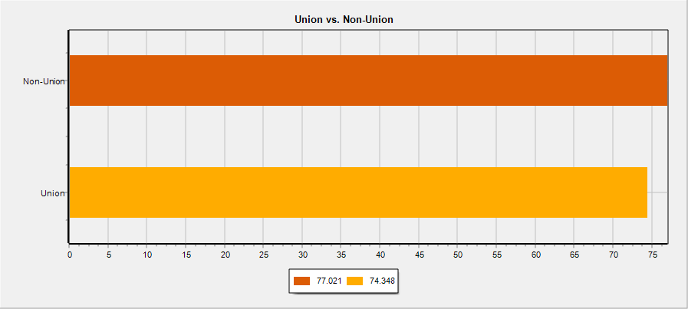
Listen to / Respect Front-Line Employees
** Cross-Comparisons use a standard measure of ‘Rate per 10,000 words’, which allows us to compare data across groups in the data while controlling for differences in the size of those groups.

Slide 11
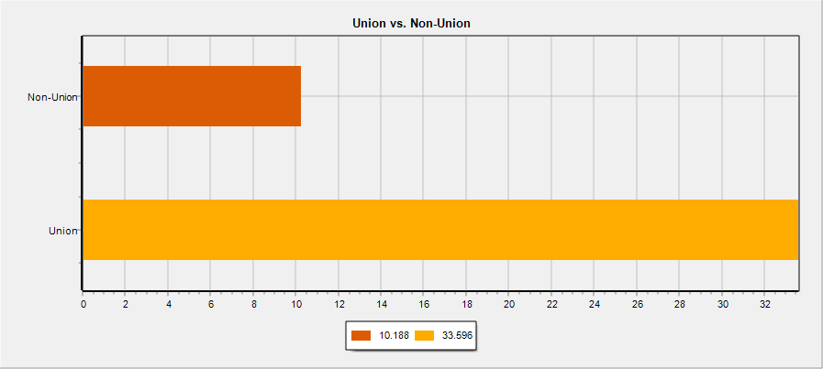
Negotiate a ‘Fair’ Contract
** Cross-Comparisons use a standard measure of ‘Rate per 10,000 words’, which allows us to compare data across groups in the data while controlling for differences in the size of those groups.

Slide 12
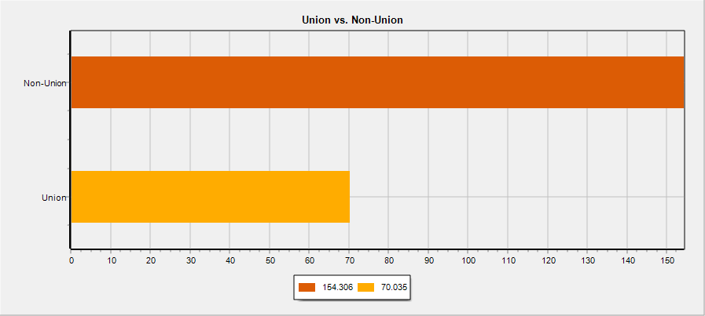
Increase Wages and Benefits to Adjust for Cost of Living
** Cross-Comparisons use a standard measure of ‘Rate per 10,000 words’, which allows us to compare data across groups in the data while controlling for differences in the size of those groups.

Slide 13
Appendix
- Coherence and Eigenvalues Measures
- Keywords and Phrases (N-Grams)

Slide 14
Coherence and Eigenvalue Measures
The tool uses coherence (Yule’s Q) to tell the researcher the relative extent to which the tool sees a connection between the words and phrases (N-Grams) it has brought together into a topic. The researcher is the ultimate judge as to whether a topic is truly coherent.
Eigenvalues represent the total amount of variance in the data that can be explained by a given topic. While any Eigenvalue above ‘0’ is good, stronger Eigenvalues generally denote that more variance in the qualitative data (words being written) is being explained by the topic, while a lower value denotes less variance being explained in the data by the topic. While our researches need these values to guide the statistical validity of our reported themes, we recommend assessing the themes by their reported frequency in the primary body of the report.
Theme/Topic | Coherence (Yule’s Q) | Eigenvalue
Improve Customer Experience: Coordination of Service Provisions | .784 | 1.70
Improve Customer Experience: Infrastructure Investments | .753 | 1.71
Listen to / Respect Front-Line Employees | .829 | 1.69
Improve Training | .747 | 1.67
Increase Wages and Benefits to Adjust for Cost of Living | .932 | 3.14
Update Computers & Systems | .716 | 2.04
Work-Life Balance | .707 | 1.83
Management Concerns | .712 | 1.64
Improve Internal Alignment, Collaboration, and Communication | .819 | 2.73
Negotiate a ‘Fair’ Contract | .853 | 1.96
Increase Accountability | .640 | 1.97
Need for Expanded and Upgraded Fleet | .684 | 1.64

Slide 15
Keywords and Phrases (N-Grams)
Theme/Topic | Key Words and Phrases (N-Grams)
Improve Customer Experience: Coordination of Service Provisions | TICKET; TROUBLE; TROUBLE TICKET; TIMELY; IN A TIMELY; IN A TIMELY MANNER; CALL IN; CUSTOMER IN; ISSUE; RESOLVE; TICKET; TO CALL; HAVE TO CALL; THE PHONE; CUSTOMER ON; WITH CUSTOMER; DATE; DELAY; CUSTOMER; APPOINTMENT; ISSUE; DUE DATE; THE CUSTOMER AND;
Improve Customer Experience: Infrastructure Investments | CUSTOMER; SERVICE; COPPER; FIBER; CUSTOMER SERVICE; THE CUSTOMER; SERVICE AND; TAKE CARE OF THE; CUSTOMER SERVICE AND; TERMINAL; POLE; HUB; FIBER; THE FIBER; COPPER; FIBER; PLANT; COPPER PLANT; THE COPPER; COPPER CABLE; COPPER CUSTOMER; FIBER BE; GET FIBER; TO FIBER; FIBER TO; FIBER IN; FIBER INSTALL; WITH FIBER; FIBER AND;
Listen to / Respect Front-Line Employees | FRONT; FRONT LINE; THE FRONT LINE; FRONT LINE EMPLOYEE; ON THE FRONT LINE; EMPLOYEE; TREAT; SHOW; LISTEN TO; LISTEN; CARE; RESPECT;
Improve Training | TRAIN; PROVIDE; CORNERSTONE; NEW EQUIPMENT; NEW PRODUCT; TRAIN ON;
Increase Wages and Benefits to Adjust for Cost of Living | COST; INCREASE; INFLATION; WAGE; PAY; MEDICAL; INSURANCE; RAISE; HEALTH; BENEFIT; MATCH; COST OF; COST OF LIVE; THE COST OF; PAY INCREASE; INFLATION AND; TO MATCH; WITH INFLATION; INCREASE IN; INCREASE PAY; PAY RAISE; WAGE INCREASE; HEALTH CARE; IN PAY; PAY TO; SALARY; PAY; PROMOTION; BONUS; CONTRIBUTION; BRING BACK;
Update Computers & Systems | SYSTEM; DPI; SLOW; COMPUTER; UPDATE;
Work-Life Balance | LIFE; BALANCE; FAMILY; LIFE BALANCE; WORK LIFE BALANCE; GOOD WORK LIFE BALANCE; SCHEDULE; FORCE; VACATION; DAY WORK WEEK; DAY OFF; DAY A WEEK; HOUR DAY; HIRE;
Management Concerns | MANAGEMENT; UPPER; THE TOP; THE BOTTOM; UPPER MANAGEMENT; LEVEL MANAGEMENT; TOP DOWN; MANAGEMENT THAT; FROM THE TOP; MANAGEMENT TO; MIDDLE MANAGEMENT; MANAGER; MICRO; LOCAL MANAGER;
Improve Internal Alignment, Collaboration, and Communication | COMMUNICATION; FUNCTIONAL; COLLABORATION; GOAL; ALIGN; COMMUNICATION BETWEEN; CROSS FUNCTIONAL; COMMUNICATION BETWEEN DEPARTMENT; ON THE SAME PAGE;
Negotiate a ‘Fair’ Contract | CONTRACT; FAIR; UNION; AGREE; FAIR CONTRACT; A FAIR CONTRACT; GIVE US; GIVE US A FAIR CONTRACT; A CONTRACT; CONTRACT WITH; CONTRACT AND; PROVIDE A; AGREE TO;
Increase Accountability | HOLD; ACCOUNTABLE; ACCOUNTABLE FOR; ACCOUNTABLE FOR THEY;
Need for Expanded and Upgraded Fleet | TRUCK; BUCKET; VAN; BUCKET TRUCK;
Note: while the primary report displays topics by frequency alone, it is both the frequency of these words and phrases (N-Grams), as well as how they’re used together by respondents that determines the creation of topics in the modelling process.

Slide 16
Methodology (1/2)
Lexical Analysis / Tokenization
Comments get broken into sequences of separate sentences.
Sentences get broken into sequences of separate words (Tokens).
Words with low-level information (e.g., ‘that’, ‘we’, ‘have’) are marked as Stop Words that the tool knows to ignore when searching for meaningful language to define themes/topics.
Syntax Analysis
Words are assessed by their usage within sentences to identify their ‘Part-of-Speech’ (POS) (e.g., ‘verb’ vs. ‘noun’), and each word is tagged with a POS.
Words are transformed into the root form (lemma) of each word through Lemmatization.*
Semantic Analysis
Words and phrases (N-Grams) are given meaning through the sentences that host them.
Entity Recognition identifies words and phrases (N-Grams) that could be referring to the same person, organization, etc. (e.g., “Denison Consulting” vs. “Denison” and “Consulting”), which gives meaning to entities in the language being processed.
WordNet (a database of semantic relations between words) is used to develop synsets, which are groups of words that reflect the same meaning.
*We conduct Syntax Analysis through Lemmatization rather than Stemming. While it takes more time, Lemmatization offers much higher precision.

Slide 17
Methodology (2/2)
4. Discourse Processing
Using knowledge gained in the three previous steps, the Text Analysis tool identifies a researcher-specified number of topics by bringing together words and phrases (N-Grams) that are being used together or to describe the same phenomena.
5. Pragmatic Analysis
The researcher then conducts Supervised Discourse Segmentation, combining knowledge of the client organization and the question prompting the open-ended response data, in order to identify which topics are ‘cohesive’.
This is where the intelligence of the tool and the researcher’s sensibility and knowledge of the context around the data come together to identify clear and meaningful topics/themes.

