Slide 1
Survey Design, Feedback, & Performance Linkages
Michael Schwendeman
Director of R&D
mschwendeman@denisonculture.com

Slide 2
Today’s Agenda, Guided by You
Culture & COVID Research
March 2021 Webinar
May 2021 Forum Presentation
March 2022 Webinar
Linkage Analyses
Growth Metrics
Customer Satisfaction
Driver Analyses
Engagement
Safety (with deep dive)
Text Analyses
Improving Customer Experience
Where should we start?
​ We’ve dedicated this time connecting and answering questions – you guide us.​
2

Slide 3
Culture & COVID Research
3

Slide 4
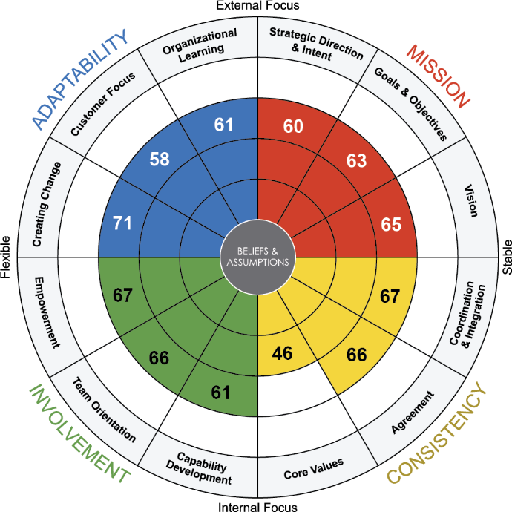
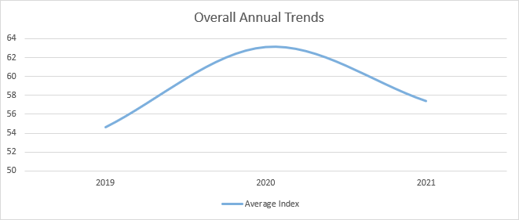
Culture & COVID Research: Overall Trends
Culture scores generally got stronger in the early stages of the pandemic, and have since leveled out
At the onset of the pandemic in early 2020, there was fear, confusion, and uncertainty for many both in their personal lives as well as their professional lives
Following the beginning of 2020, culture scores grew steadily throughout the year as organizations clarified and aligned around new ways of working
Though still strong, culture scores have since regressed towards pre-pandemic levels in 2021 as organizations figure out how to internalize learnings and bounce forward
N = 140 organizations
4

Slide 5
Culture & COVID Research: Index & Item Scores
HIGHEST INDEXES
HIGHEST ITEMS
Creating Change: Employees and organizations could read the external environment and react to trends and changes; many organizations were constantly looking for ways to improve and change their work.
73
Different parts of the organization often cooperate to create change.
71
71
The way things are done is very flexible and easy to change.
Empowerment: Employees were informed and involved in the work that was done and felt as though they had a positive impact.
70
It is easy to coordinate projects across different parts of the organization.
67
69
Authority is delegated so that people can act on their own.
Coordination & Integration: Employees shared a common perspective that allowed them to work effectively across organizational boundaries. Everyone worked to eliminate “silos” and promoted actions that were in the best interest of the organization as a whole.
69
We are able to meet short-term demands without compromising our long-term vision.
67
LOWEST ITEMS
Team Orientation: Teamwork was encouraged and practiced in organizations. Employees valued collaboration and felt mutually accountable for common goals.
39
There is an ethical code that guides our behavior and tells us right from wrong.
66
46
We encourage direct contact with customers by our people.
LOWEST INDEX
47
When people ignore core values, they are held accountable.
50
The leadership has clearly stated the objectives we are trying to meet.
Core Values: Setting and sharing a set of values was challenging, and many struggled to have a strong sense of identity and set clear expectations that leaders reinforced.
46
51
The capabilities of people are viewed as an important source of competitive advantage.
N = 140 organizations
5

Slide 6
Deeper Insights through Analytics
6

Slide 7
Performance Analytics Overview
At Denison, we frequently couple performance analytics with qualitative analysis:
Demonstrating the link between culture and performance/employee outcomes
Systematically analyzing text responses to open-ended survey items
Theme 1
Theme 2
Theme 3
Ex: Driver Analysis, Linkage Analysis
Ex: Text Analysis (Natural Language Processing, Manual)
7

Slide 8
Linking Culture and Employee Outcomes
8

Slide 9
Top Cultural Drivers of Engagement
2022: Overall
We identified cultural behaviors and values that are positively related to Engagement that may provide unique points of leverage for improvement. These items were broken out into areas you should sustain positive scores (high relationship strength, relatively high percentile) and areas you have the most room to improve (high relationship strength, relatively low percentile).
Index | Relationship Strength | Unique Cultural Drivers to Sustain | Percentile | Impact
Core Values | 2 | There is a clear and consistent set of values that governs the way we do business. | 79 | High
Strategic Direction & Intent | 4 | There is a clear mission that gives meaning and direction to our work. | 86 | Medium
Team Orientation | 5 | Work is organized so that each person can see the relationship between his or her job and the goals of the organization. | 86 | Medium
Vision | 7 | We have a shared vision of what the organization will be like in the future. | 81 | Medium
Coordination & Integration | 8 | There is good alignment of goals across levels. | 78 | Medium
Engagement
0
PERCENTILE
25th
50th
75th
100th
Index | Relationship Strength | Unique Cultural Drivers to Improve | Percentile | Impact
Vision | 1 | Our vision creates excitement and motivation for our employees. | 67 | High
Organizational Learning | 3 | Learning is an important objective in our day-to-day work. | 41 | High
Strategic Direction & Intent | 6 | There is a long-term purpose and direction. | 65 | Medium
Strategic Direction & Intent | 9 | There is a clear strategy for the future. | 63 | Medium
Capability Development | 10 | The “bench strength” (capability of people) is constantly improving. | 67 | Medium
70
9

Slide 10
Top Cultural Drivers of Safety
2020: Overall
We identified cultural behaviors and values that are positively related to Safety that may provide unique points of leverage for improvement. These items were broken out into areas you should sustain positive scores (high relationship strength, relatively high percentile) and areas you have the most room to improve (high relationship strength, relatively low percentile).
Index | Relationship Strength | Unique Cultural Drivers to Sustain | Percentile | Impact
Vision | 2 | Our vision creates excitement and motivation for our employees. | 83 | Very High
Strategic Direction & Intent | 4 | We are able to meet short-term demands without compromising our long-term vision. | 92 | High
Strategic Direction & Intent | 7 | We have a shared vision of what the organization will be like in the future. | 93 | High
Coordination & Integration | 8 | There is good alignment of goals across levels. | 90 | High
Goals & Objectives | 9 | We continuously track our progress against our stated goals. | 83 | High
“Safety is an important attitude that should & needs to be a priority focus of every teammate!”
Safety
0
PERCENTILE
25th
50th
75th
100th
67
Index | Relationship Strength | Unique Cultural Drivers to Improve | Percentile | Impact
Vision | 1 | Leaders have a long-term viewpoint. | 74 | Very High
Strategic Direction & Intent | 3 | There is a clear mission that gives meaning and direction to our work. | 78 | Very High
Goals & Objectives | 5 | The leadership has clearly stated the objectives we are trying to meet. | 77 | High
Strategic Direction & Intent | 6 | There is a long-term purpose and direction. | 75 | High
Core Values | 10 | The leaders and managers “practice what they preach.” | 50 | High
“Convincing everyone but especially our field personnel in taking more ownership of our core values, especially safety… Complacency seems to be our biggest enemy.”
10

Slide 11
Example: Position = Engineer
2018: ENGINEER
2020: ENGINEER
YOY Change
2018: ENGINEER
YOY Change
Strategic Direction & Intent
22
11
2020: ENGINEER
There is a long-term purpose and direction.
61
95
+34
Our strategy leads other organizations to change the way they compete in the industry.
72
93
+21
Safety
There is a clear mission that gives meaning and direction to our work.
81
91
+10
64
95
+31
There is a clear strategy for the future.
69
91
+22
41
99
+58
All leaders demonstrate strong commitment to safety.
Goals & Objectives
62
98
+36
Safety is the number one priority in everything we do.
There is widespread agreement about goals.
74
97
+23
68
96
+28
We have all the tools and resources needed to work safely.
Leaders set goals that are ambitious, but realistic.
79
97
+18
53
96
+43
Teammates take personal ownership for each other's safety.
The leadership has clearly stated the objectives we are trying to meet.
70
77
+7
84
95
+11
Teammates contribute to the development of our safety practices.
We continuously track our progress against our stated goals.
79
86
+7
57
79
+22
We always work safely, even under high pressure.
We continually look for new ways to work safely.
75
95
+20
Vision
We work to gain a deep understanding of all
near-misses. (or "close calls").
We have a shared vision of what the organization will be like in the future.
80
97
+17
55
96
+41
67
98
+31
People from different parts of the organization work together
in a way that ensures their safety.
68
95
+27
Leaders have a long-term viewpoint.
Our vision creates excitement and motivation for our teammates.
71
97
+26
34
91
+57
All safety issues are reported quickly to leaders and managers.
90
99
+9
86
96
+10
Leaders and managers act quickly to resolve all safety issues.
We are able to meet short-term demands without compromising our long-term vision.
Considering everything, this organization
is a very safe place to work.
Core Values
74
96
+22
The leaders and managers “practice what they preach”.
49
92
+43
Coordination & Integration
There is good alignment of goals across levels..
86
99
+13
11

Slide 12
Example: Position = Heavy Equipment Operator
2018: Operator
2020: Operator
YOY Change
2018: Operator
YOY Change
2020: Operator
Strategic Direction & Intent
There is a long-term purpose and direction.
93
34
-59
Safety
92
12
-80
Our strategy leads other organizations to change the way they compete in the industry.
95
76
-19
All leaders demonstrate strong commitment to safety.
64
2
-62
There is a clear mission that gives meaning and direction to our work.
93
18
-75
Safety is the number one priority in everything we do.
93
10
-83
There is a clear strategy for the future.
97
28
-69
We have all the tools and resources needed to work safely.
97
24
-73
Goals & Objectives
90
7
-83
Teammates take personal ownership for each other's safety.
There is widespread agreement about goals.
97
56
-41
Teammates contribute to the development of our safety practices.
90
17
-73
Leaders set goals that are ambitious, but realistic.
97
15
-82
We always work safely, even under high pressure.
91
38
-53
The leadership has clearly stated the objectives we are trying to meet.
94
16
-78
We continually look for new ways to work safely.
95
17
-78
We continuously track our progress against our stated goals.
94
25
-69
We work to gain a deep understanding of all
near-misses. (or "close calls").
93
38
-55
Vision
People from different parts of the organization work together
in a way that ensures their safety.
95
18
-77
We have a shared vision of what the organization will be like in the future.
98
67
-31
70
6
-64
All safety issues are reported quickly to leaders and managers.
Leaders have a long-term viewpoint.
95
26
-69
90
12
-78
Leaders and managers act quickly to resolve all safety issues.
Our vision creates excitement and motivation for our teammates.
93
62
-31
Considering everything, this organization
is a very safe place to work.
93
15
-78
We are able to meet short-term demands without compromising our long-term vision.
98
64
-34
Core Values
The leaders and managers “practice what they preach”.
91
5
-86
Coordination & Integration
There is good alignment of goals across levels..
95
60
-35
12

Slide 13
Linking Culture and Performance Outcomes
13

Slide 14
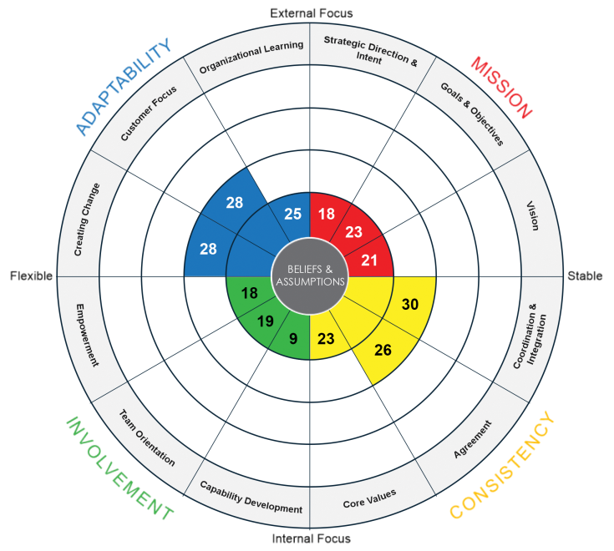
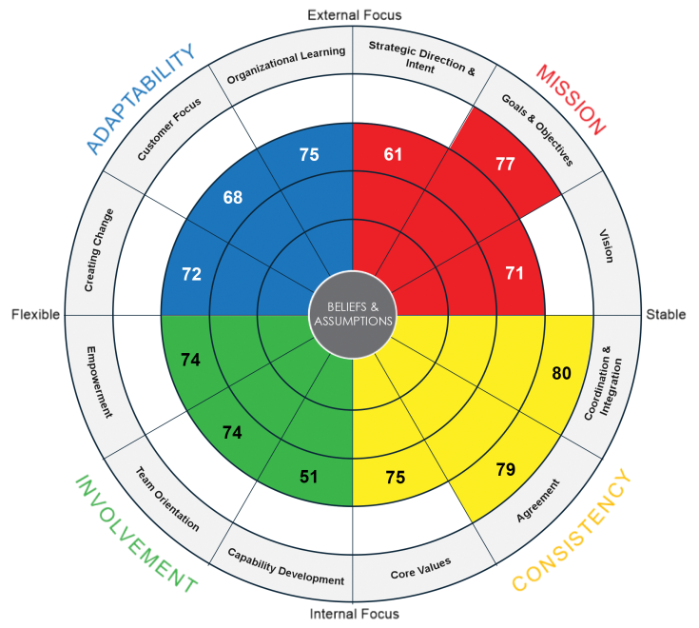
Linking Culture and Growth Metrics
Higher culture scores translate to better value creation and return
Bottom 30 Companies
Top 30 Companies
EBITDA Growth
-1%
17%
Sales Growth
-4%
6%
This study of 60 companies shows that firms with the best culture had the best performance
14

Slide 15
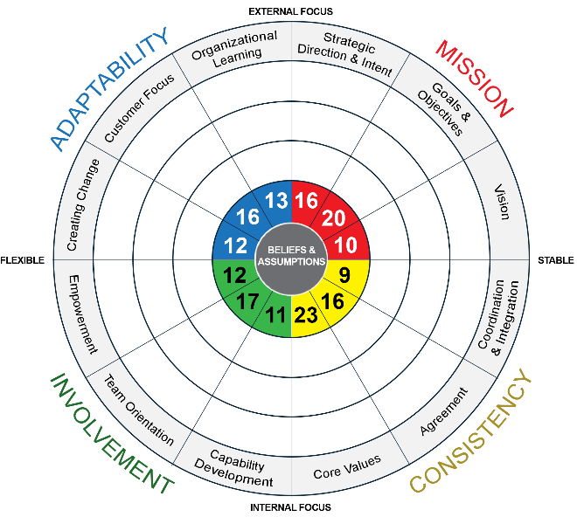
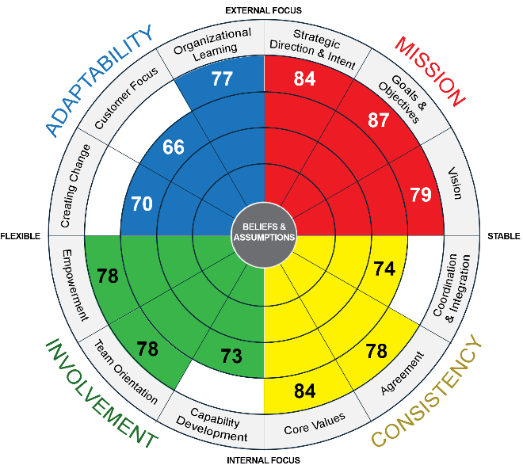
Linking Culture and Growth Metrics
The higher the culture scores,
the better the financial performance
Bottom 25%
Top 25%
Return-on-Assets
2.3%
3.2%
Sales Growth
1.4%
23.1%
Market-to-Book Ratio
2.6
4
This study of 130 firms shows that firms with the best culture had much stronger sales growth
15

Slide 16
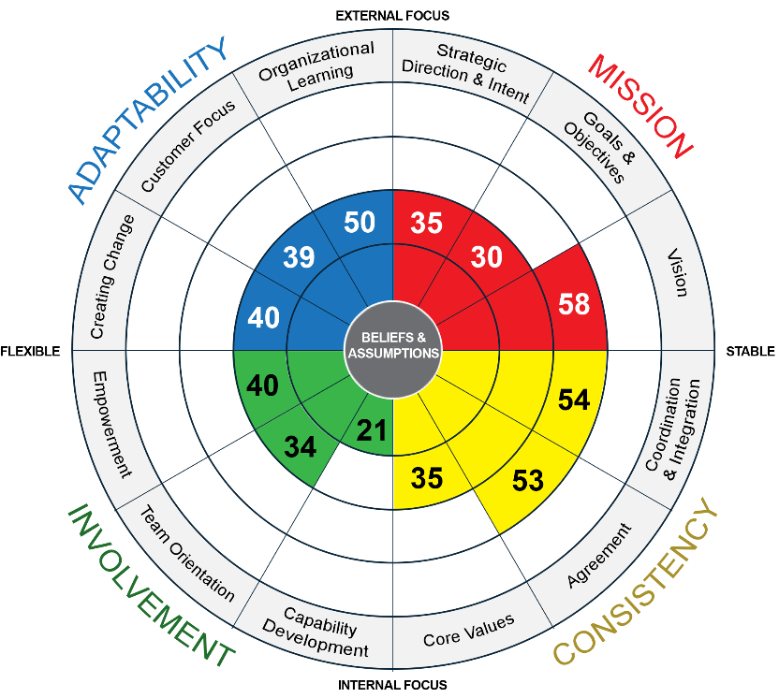
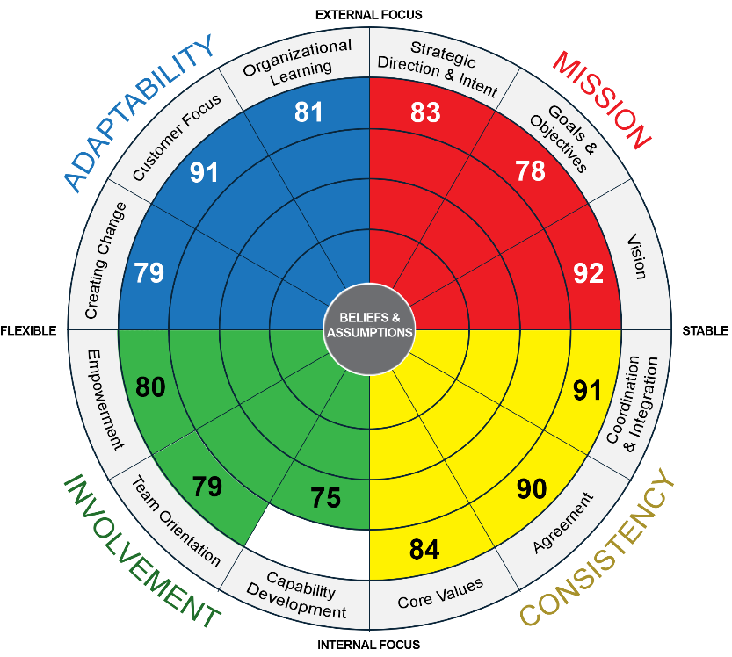
Linking Culture and Customer Satisfaction
Study of Automotive Service Centers
Total of 338 dealerships and over 12,000 employees
Compares organizational culture and customer satisfaction
Below 50% Highly Satisfied
Above 80% Highly Satisfied
This study shows that dealers with the best culture had much stronger customer satisfaction
16

Slide 17
Analyzing Survey Comments
17

Slide 18
Text Analysis: Uncovering the Power of Comments
Key Points
We can analyze responses to any question on any survey.
The price is the same regardless of the number of comments.
Generally, comments must be in English or translated into English.
Survey comment analysis is best paired with an executive report that captures and summarizes survey results and qualitative responses.
Any number of comments can be analyzed in excess of around 400.
Questions with fewer than 400 comments can be analyzed manually for approximately the same price.
18

Slide 19
Key Insights
Sample Report
Question: What is the most important thing our organization can do to improve the customer experience?
Employees overwhelmingly stressed improving customer-facing technology as the top way to enhance customer experience. Suggestions spanned many topics from software (improving online banking, the mobile app, internal systems, etc.) to hardware (improving ATMs, scanners, employee computers). Improving technology will also empower customers to help themselves.
Improving employee retention, training, development, and compensation were frequently mentioned as necessary to ensuring customers have a good experience. In addition, employees suggested improving staffing or the size of float teams to reduce customer wait times at certain branches.
Leveraging and developing the community aspect of the bank, from localizing and speeding up decisions to offering more financial counseling and support, was also a key theme. Employees viewed being a community bank as a key competitive advantage that can be developed further.
19

Slide 20
Results Overview
Sample Report
Question: What is the most important thing our organization can do to improve the customer experience?
20

Slide 21
In-Depth Results
Sample Report
This page presents the themes surfaced from our analysis, ranked in order of frequency, along with a description of the theme or employee suggestion and one or more representative comments.
Suggestion | Description | Representative Comment(s)
1. Improve Technology | The general need to improve the bank’s technology, and especially customer-facing technology such as online banking and the mobile app. | “More technological advances, technology is extremely outdated. Never banked with or work for another bank who didn’t offer customers a full online banking experience, we do not offer online statements, 1098s, or even payoffs for loans.”
2. Focus on Retaining and Developing Employees | High turnover and lack of effective developmental opportunities for employees negatively influences customer experience. | “Customers love seeing familiar faces, and with high turnover, they wonder why we lose their trusted and favorite bank people…happy employees are more productive and spread their happiness to others.”
3. Increase Number of Employees | The belief that some branches are not adequately staffed, which results in a poor customer experience. | “Better staffing models in all branches. There is not enough staff in each branch location. Employees are stretched to their max. This is when mistakes happen and the atmosphere of the branches and performance changes.”
4. Improve Decision Speed & Localize More Decisions | Underwriting and loan approval take too long; allow local branches more decision-making authority. | “Speed up the approval process. We have gotten away from being able to provide quick responses. This is mainly due to the elimination of loan authority, the time to input into the system and the work load of the credit analysis and risk managers” and “Invest in local communities and not centralize everything at headquarters”
5. Empower Customers to Help Themselves | Related to improving technology generally, develop further customer-facing technology systems that allow customers to help themselves. | “Continue to find ways to make banking easier for our customers”
6. Improve Customer Service | General comments related to improving customer service. Service should be consistently high quality, and the bank should not neglect current customers at the expense of growth. | “To strive for consistent and quality service at all levels of customer interaction”
21

Slide 22
In-Depth Results
Sample Report
This page presents the themes surfaced from our analysis, ranked in order of frequency, along with a description of the theme or employee suggestion and one or more representative comments.
Suggestion | Description | Representative Comment(s)
7. Offer New Products | Add new mid-marking checking accounts and other products that fit within the current offerings; reduce fees | “Offer a mid-range checking account again. One that offers the opportunity to earn some interest without having to keep such a high balance. I feel a lot of customers would appreciate and take advantage of this option” and “Lower the balance on the basic savings account…lower the checking cashing fee…not charging so many overdraft fees”
8. Improve Call Center | Specific comments related to improving customer service by addressing various issues at call centers such as poor training, slow response times, improper call routing, and general disorganization. | “Improve the quality of the Customer Care Center. Simple questions take forever to resolve and customers are often routed to the wrong contact resulting in frustration.”
9. Improve ATMs and Debit Card Issuance Speed | ATMs often fail or present errors that result in customer frustration; It takes too long for customers to receive debit cards. | “The ATMs are probably the biggest complaint I get. They tend to go down regularly in locations with older ATMs and the customers want to be able to rely on us to have functioning ATMs all the time” and “Instant issue debit cards! Sign on the ATMs stating the cut-off time for deposits”
10. Focus on Financial Health Counseling | Provide more financial health services to customers to solidify the bank’s sense as community-focused. | “There is more we can do from a financial health perspective. We have an opportunity with people who have made the choice for a community bank to grow financially. Who can they talk to who is certified to advise them on their credit? How do they know how to budget? How can they learn about investing (without having to pay for it?) FAQs aren’t enough.”
11. Increase Employee Recognition and Compensation | Desire to increase employee benefits, compensation, and recognition. | “We are told that all of our roles are important to the success of the organization; however, there is a clear delineation of how employees are rewarded when bonuses are given. It is demoralizing to be told your role is extremely important to the bank/team and a specific portfolio only to be giving a fraction of the bonus that others are receiving in your area.”
22

Slide 23
Discussion
Questions/Comments?
​ We’ve dedicated this time for an open conversation.​
Thank you for joining!
23

Slide 24
Appendix
24

Slide 25
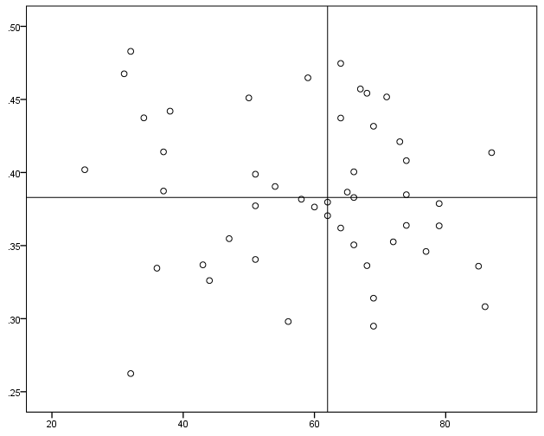
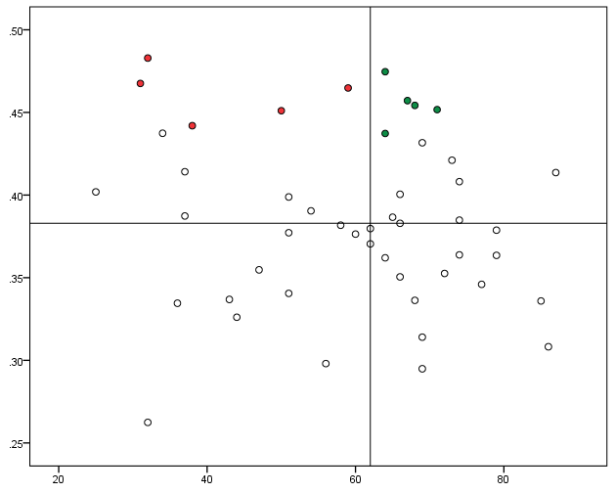
Driver Analysis – Methodology
2022: Overall
Step 1
Step 2
Step 3
The scores for all items in your culture survey were plotted out based on their percentile score and the strength of their relationship (i.e., correlation coefficient) with the outcome module. Quadrants were established by applying a median spilt (i.e., a division based on the middle score) on both percentile score and relationship strength.
The ten items with the strongest relationship across the top two quadrants were identified as the top drivers of the outcome module. Items in the top right quadrant represent areas to sustain positive scores (relatively higher percentile scores) and items in the top left quadrant represent areas to improve (relatively lower percentile scores).
An Impact Score was generated for each of the ten items identified as having the strongest relationship strength among all the culture items. Impact Scores represent ranges of relationship strengths (i.e., correlation coefficient) and bucketed according to the benchmark below.
Relationship
Strength
Relationship
Strength
Improve
Sustain
Relationship Strength | Impact Score
≥ .60 | Very High
.50 - .59 | High
.40 - .49 | Medium
.30 - .39 | Low
< .30 | Insignificant
Percentile Score
Percentile Score
25

Slide 26
Text Analysis Methodology
Step 1 – Data Cleaning
Responses to open-ended questions posed on the survey were put through various text cleaning mechanisms. These mechanisms removed blank responses, punctuation, and stop words (e.g., “and”, useless words in language processing). After a preliminary analysis, additional stop words were removed from all responses specific to the question. Finally, the remaining words from each response were stemmed (reduced to the root; e.g., manage, manages, managed, and manager become manag) in order to best derive insights from the collection of responses.
Step 2 – Initial Theme Generation
A collection of models was created for each question using the stm (structural topic models) package in the statistical analysis program R. Models were created ranging from 2 to 30 themes. The optimal number of themes for each question was then selected by examining three statistical indicators of model quality: (1) held-out likelihood, (2) residuals, and (3) semantic coherence.
Step 3 – Final Theme Selection
After selecting the optimal model for each question, the properties of each emergent theme were examined in order to define the theme. As part of this process, words with the highest probability of appearing in each theme and words most exclusive to each theme were considered. Additionally, the top 10 responses with the highest probability of being assigned to each theme were examined.
Step 4 – Theme Analysis
Using the optimal model for each question, the proportion of responses that belonged to each theme was used to create the report, descriptions and representative comments for each theme were generated, and key insights were summarized.
26

Slide 27
Text Analysis Interpretation Guide
The Models
Independent models were created for each question, meaning that a different sample of responses was used to develop the themes in each model. This allowed for the emergence of a unique pattern of themes at varying levels of specificity. Within each model, themes were created to draw high-level conclusions about rater responses.
The Themes
The text analysis reports identify the general themes that were discussed by survey respondents based on the frequency of words that appeared in responses. These reports are meant to identify the broad themes that are most frequently discussed across respondents in a given group, while more specific insights can be drawn by exploring verbatim rater comments.
Overall, these results provide information regarding themes representative of what is generally most important to respondents.
27

