Slide 1
Leading a High-Performance Culture
Action Planning

Slide 2
Moving from Data to Action…….
Parallel Path to Action Planning
Organization-wide actions
Department/Team/Group Actions
Department/Team/Group Actions
Leader/Manager Actions
2

Slide 3
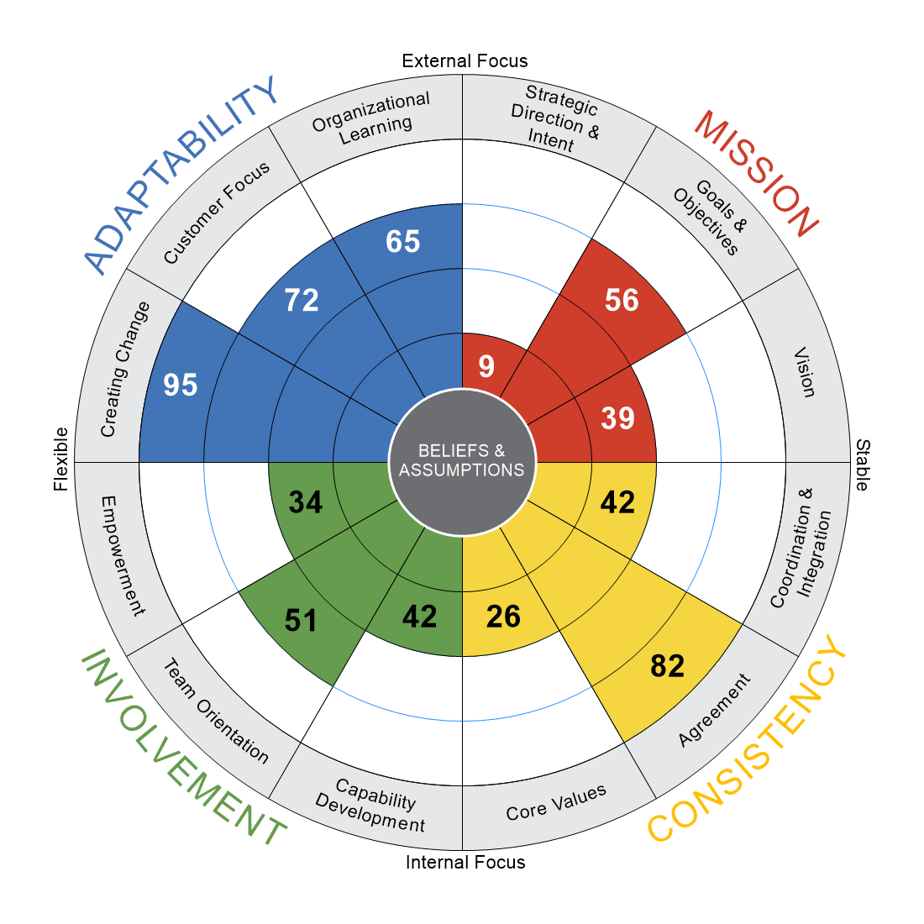
Setting the stage for Action Planning
What are the top business priorities for our group as we look out 18 – 24 months?
What do we see in the culture data that has us positioned for success? (strengths we want to maintain and build on)
3) What do we see in the culture data that might be a barrier to our success?

Slide 4
Action Planning 5 Steps:
Step 1 Objective:
Develop Problem Statement(s). Clearly define the problem(s) connected to the focus area(s) identified
Step 2 Objective:
Identify root causes (5 WHY’s)
Step 3 Objective: (Ideation)
Brainstorm ideas addressing root causes
Step 4 Objective:
Prioritize ideas: Consider level of impact, ease of access, quick wins
Step 5 Objective:
Sort prioritized actions and develop Action Plan
(Action Plan Template)

Slide 5
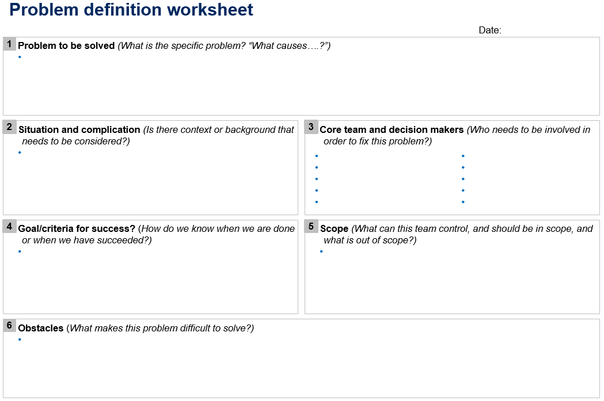
For Each Action Item Consider the Following When Taking Next Steps

Slide 6
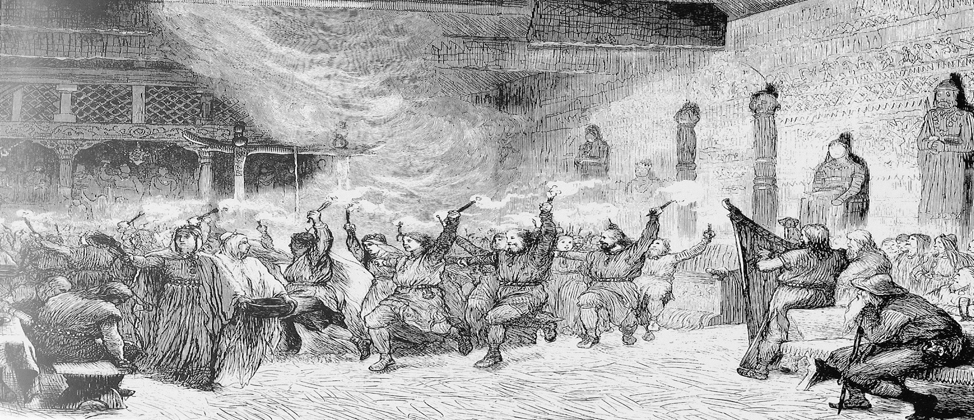
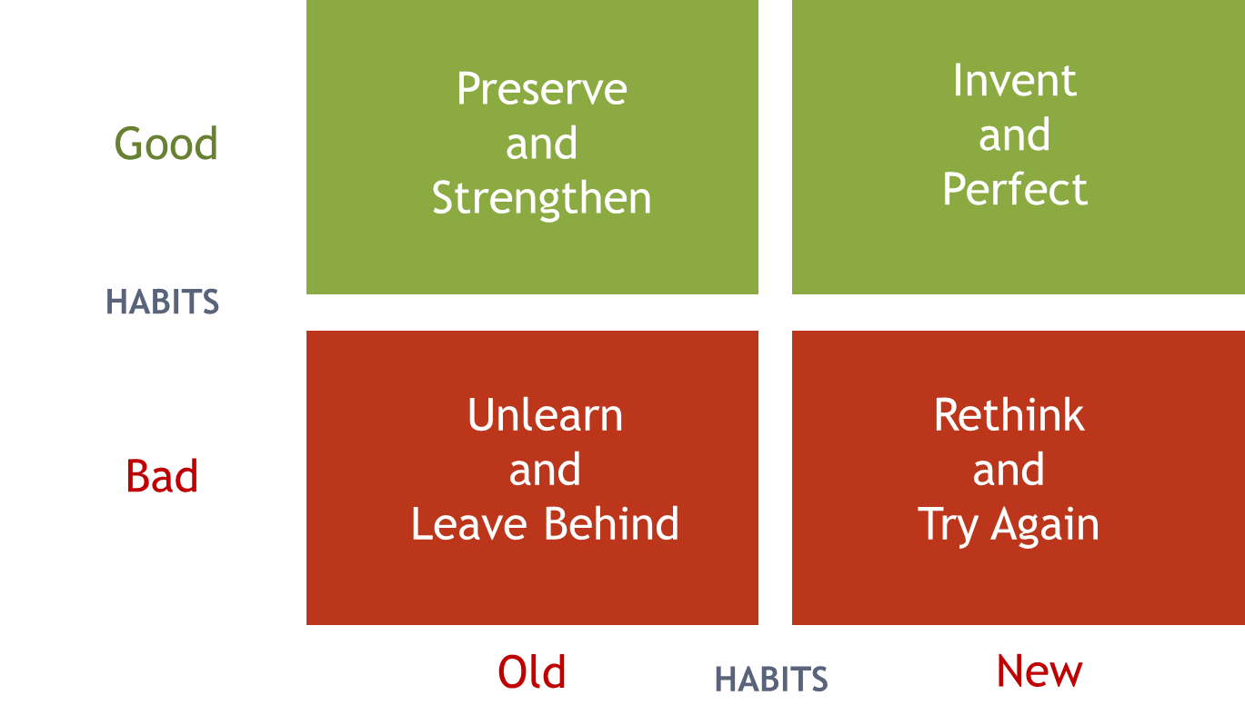
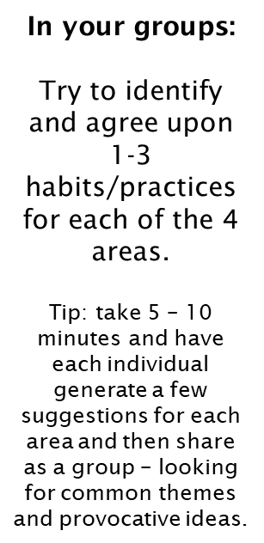
Habit Change Exercise Review
(Good, old habits that we believe help us get our work done effectively)
(New habits that we need to invent that we believe will move us in the direction desired)
(Bad old habits that we believe prevent or inhibit our ability to get work done)
(New habits we’ve developed in the past 12 months that are well intended, but have not produced the desired impact and need to be rethought)

Slide 7
Action Items
A. Follow-through/weekly follow-ups
Prioritization Matrix
B. Early communication to managers
IMPACT
C. Provide goals/areas for development
(4)
(3)
(1) Quick Wins
B
F
C
G
EMPT: How do we ensure communication is consistently being cascaded down from the top down on important issues?
HIGH
I
E
D
H
D. Clarify who owns strategy
J
E. Build up capabilities of managers/leaders to think strategically
(7)
(5)
(2)
A
MEDIUM
F. Create/communicate roadmap for strategy
SD & I: How do we create and communicate a roadmap to meet our mission and how do we connect and align our 5 strategic prioritizes
(9)
(8)
(6)
G. Rewarding/public acknowledgment
LOW
H. 360 feedback
C&I: How can we encourage transparency to eliminate the “knowledge is power” ideology?
I. Encourage senior leadership to model transparency
HIGH
MEDIUM
LOW
J. Team building activities
DIFFICULTY/ RESOURCES REQUIRED

Slide 8
Action Teams
Securing the direct participation of senior leaders
Success Factor 1
Getting the right people on the “Action Team”
Success Factor 2
Establishing a productive operating rhythm
Success Factor 3

Slide 9
Action Teams
Action Team “Gives”
Brain & legwork to move us to action
Feedback that is representative of the
organization
Insight into what is being seen & heard
SLT “Gets”
A partner for aligned action
Input & perspective on strategic matters
Honest dialogue about ideas & direction

Slide 10
Action Teams
SLT “Gives”
The tone & basis for change and development
Insight into decisions & priorities
Active participation in the Action Team
Support, guidance, & “accountability boost”
Action Team “Gets”
Support for action on core issues & challenges
A partner for problem-solving & barrier removal
Visibility of actions through SLT communications

Slide 11
Taking Action on 360 Data

Slide 12
Coaching 4-Point Model

Slide 13
Development Planning
5 Characteristics of an Effective Development Plan:
Identifies specific, difficult but achievable goals
Focuses energy on a few key areas for active improvement; acknowledges other areas where increased awareness may be important
Is ongoing and allows you to Try-Evaluate-Adjust
Integrates your development plans with the strategic leadership & organization plans
Builds your accountability

