Slide 1
Organizational Culture Survey
Change Monitor Report

Slide 2
Change Monitor
The Organizational Culture Change Monitor allows a company to resurvey their personnel approximately 100 days after the initial survey on two to three customer-selected indices/Modules . The Change Monitor report measures the difference between the first and second set of survey results which helps ensure that the organization follows through with its action plans, as well as tests the effectiveness of its change initiative. For example, a sample organization targeted Involvement as the area in which to implement action plans. They took the Change Monitor on this index and a Change Monitor report was produced.
For each selected index, the Change Monitor report displays the previous percentile score, the current percentile score, and the difference between them. In addition, this information is displayed for each line item within the selected index.

Slide 3
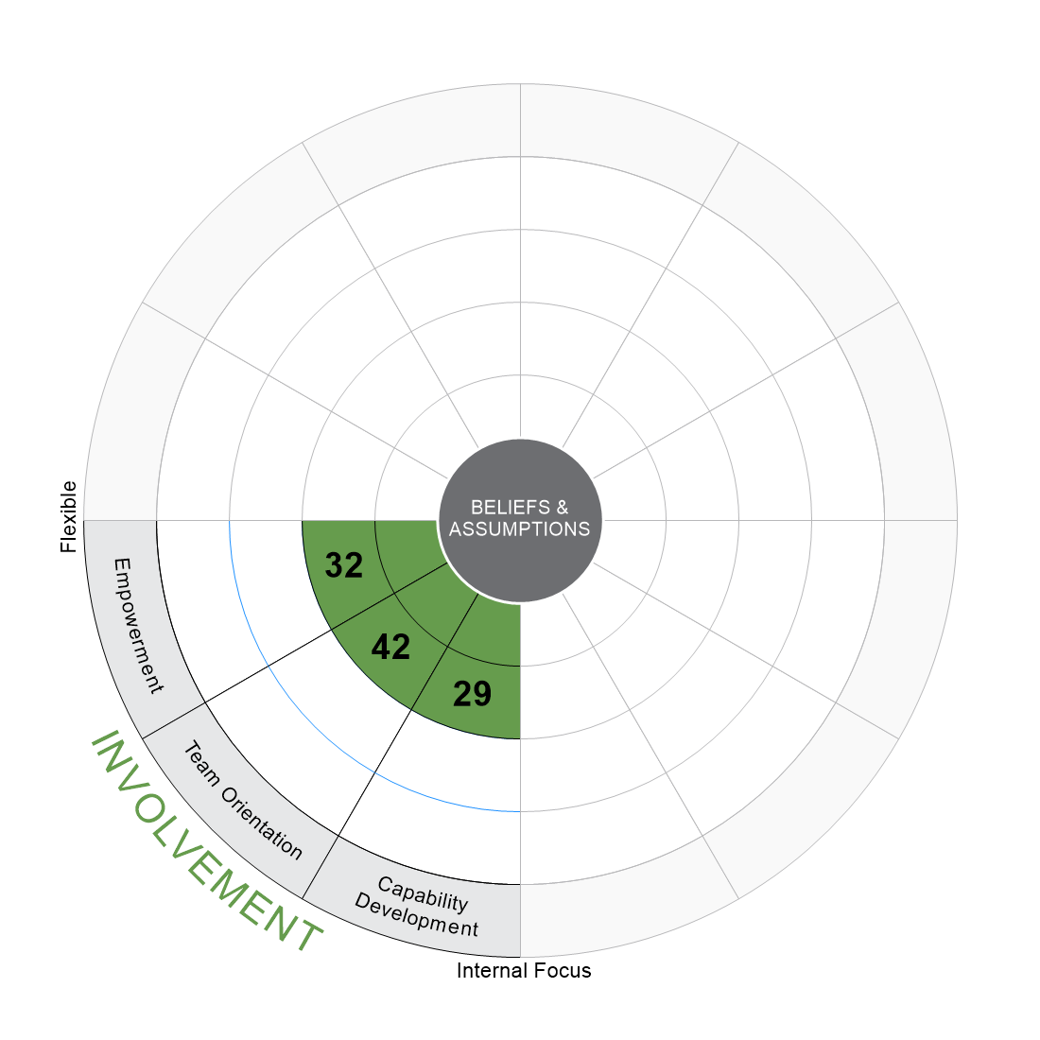
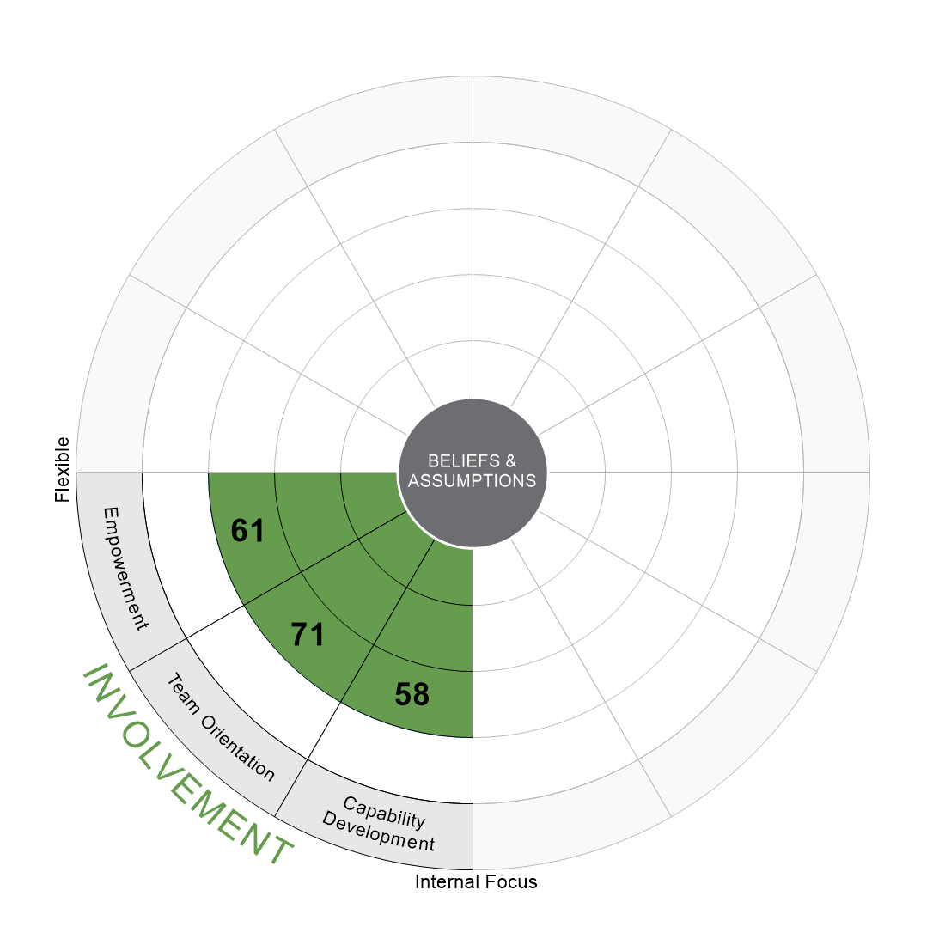
2015: Overall
2016: Overall
N = 1072
N = 1234
NUMBERS DENOTE PERCENTILES | 10/7/2016 | 2015 Normative Dataset
©Daniel R. Denison, Ph.D. All rights reserved
1

Slide 4
Index Scores
2015: Overall (N = 1072)
2016: Overall (N = 1234)
DIFFERENCE
PERCENTILE
0
25th
50th
75th
100th
Involvement
Empowerment
+29
32
61
Team Orientation
+29
42
71
Capability Development
+29
29
58
QUARTILE
1st
2nd
3rd
4th
NUMBERS DENOTE PERCENTILES | 10/7/2016 | 2015 Normative Dataset
©Daniel R. Denison, Ph.D. All rights reserved
2

Slide 5
Engagement
Employee Engagement is an enhanced positive attitude that someone feels toward their work. Engaged employees put forth extra effort and are enthusiastic, energized, and passionate. Employee engagement results can help leaders and managers understand their employees' attitudes towards their job and organization.
DIFFERENCE
PERCENTILE
2015: Overall (N = 1072)
0
25th
50th
75th
100th
2016: Overall (N = 1234)
Engagement
+17
36
53
My work drives me to go the extra mile.
+16
51
67
I am enthusiastic about working for this organization.
+24
30
54
I am proud to work for this organization.
+19
27
46
I am passionate about my work.
+15
39
54
My work energizes me.
+11
38
49
1st
2nd
3rd
4th
QUARTILE
NUMBERS DENOTE PERCENTILES | 10/7/2016 | 2015 Normative Dataset
©Daniel R. Denison, Ph.D. All rights reserved
5

